Slide 1
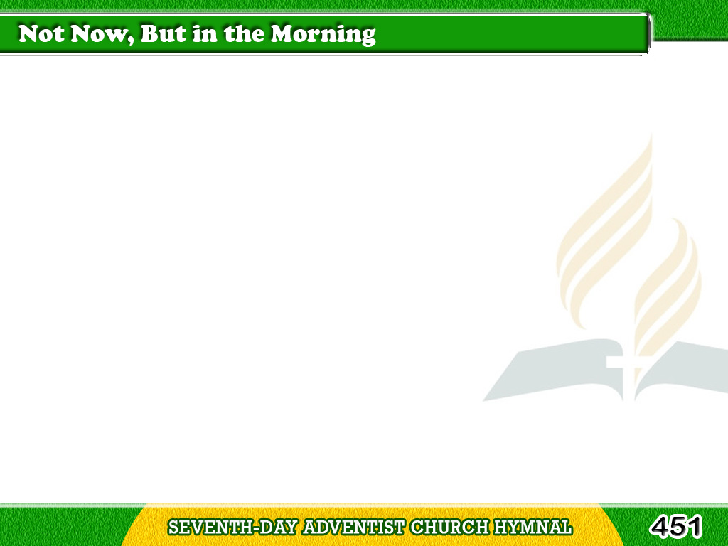
1/5
Not now, but in
the coming years,
It may be in the better land,
Tagalog
Version

Slide 2
1/5
We’ll read the meaning
of our tears,
And there, sometime,
we’ll understand.
Tagalog
Version

Slide 3
1/5
Then trust in God
through all thy days;
Fear not, for He doth hold
thy hand;
Tagalog
Version

Slide 4
1/5
Though dark thy way,
still sing and praise,
Sometime, sometime,
we’ll understand.
Tagalog
Version

Slide 5
2/5
We’ll catch
the broken thread again,
And finish what we here began;
Tagalog
Version

Slide 6
2/5
Heaven will
the mysteries explain,
And then, ah,
then we’ll understand.
Tagalog
Version

Slide 7
2/5
Then trust in God
through all thy days;
Fear not, for He doth
hold thy hand;
Tagalog
Version

Slide 8
2/5
Though dark thy way,
still sing and praise,
Sometime, sometime,
we’ll understand.
Tagalog
Version

Slide 9
3/5
We’ll know why clouds
instead of sun
Were over many
cherished plan;
Tagalog
Version

Slide 10
3/5
Why song has ceased
when scarce begun;
“Tis there, sometime,
we’ll understand.
Tagalog
Version

Slide 11
3/5
Then trust in God
through all thy days;
Fear not, for He doth
hold thy hand;
Tagalog
Version

Slide 12
3/5
Though dark thy way,
still sing and praise,
Sometime, sometime,
we’ll understand.
Tagalog
Version

Slide 13
4/5
Why what we long
for most of all,
Eludes so oft our eager hand;
Tagalog
Version

Slide 14
4/5
Why hopes are crushed
and castles fall,
Up there, sometime,
we’ll understand.
Tagalog
Version

Slide 15
4/5
Then trust in God
through all thy days;
Fear not, for He doth
hold thy hand;
Tagalog
Version

Slide 16
4/5
Though dark thy way,
still sing and praise,
Sometime, sometime,
we’ll understand.
Tagalog
Version

Slide 17
5/5
God knows the way,
He holds the key,
He guides us
with unerring hand;
Tagalog
Version

Slide 18
5/5
Sometime with
tearless eyes we’ll see;
Yes, there, up there,
we’ll understand.
Tagalog
Version

Slide 19
5/5
Then trust in God
through all thy days;
Fear not, for He doth
hold thy hand;
Tagalog
Version

Slide 20
5/5
Though dark thy way,
still sing and praise,
Sometime, sometime,
we’ll understand.
Tagalog
Version

